Slide 1
PAYROLL TAX CALCULATOR
MIS 740 Group #2 Project Demo
By : Alireza Javid, Srijana Lawa,
Siangicha Mbatia, Ying Zhao
10-04-2018

Slide 2
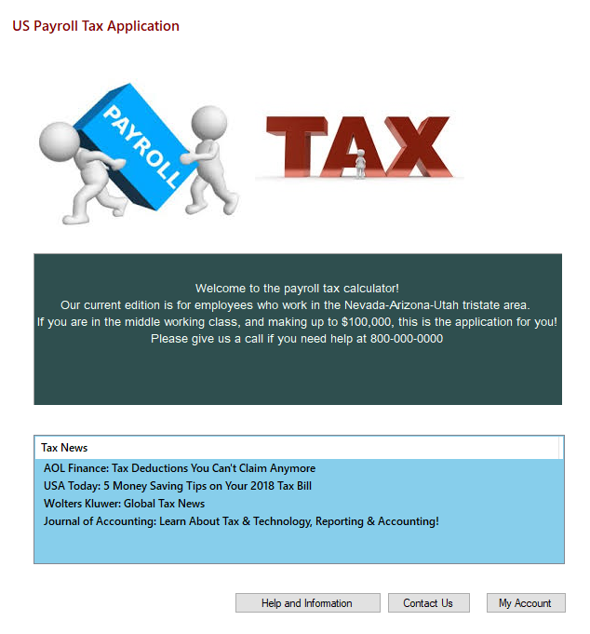
The Application - Payroll Tax Calculator
Welcome to the payroll tax calculator!
Our current edition is for employees who work in the Nevada-Arizona-Utah tristate area.
If you are in the middle working class, and making up to $100,000, this is the application for you!
Please give us a call if you need help at 800-000-0000

Slide 3
Application Production
Admin Forms (9) :
Admin Home Form
Update Helpful Links and about us Form
Add Description Form
Update contact us Form
Update Federal and state tax form
View Feedback
Federal withholding rates Form
Arizona state tax Rate Form
Utah state tax rate Form
Nevada state tax rate Form
Database (1):
Access - TaxUsers
App Forms (6):
Website Form – 4 tab pages
Sign Up Form
Login Form
Confirm Profile Form
Application and Allowance Form
Export Review Form

Slide 4
Payroll Tax Calculator
Payroll taxes are paid by employees and employers through the payroll process; every paycheck is subject to these taxes in the U.S.
Employer withholds these taxes from the employee pay and remits them to appropriate taxing agencies.
Components Involved :
Employee Info ( Personal Info Input )
Payroll Info ( Wage Info Input )
Employee Deductions & Withholds ( 5 outputs on employee side ):
Federal Insurance Contributions Act (FICA)-Employee
Medicare Tax-Employee
Federal Withholdings-Employee
State Withholdings-Employee
The subtotal.
Employer Contributions ( 5 outputs on employer side):
Federal Insurance Contributions Act (FICA)-Employer
Medicare Tax-Employer
Federal Unemployment Tax Act (FUTA) –Employer
State Unemployment Tax Act (SUTA)-Employer
The subtotal.
Take Home Net Pay ( 4 outputs in this section):
Annual, Monthly, Bi-weekly breakdowns of Amount Earned (gross pay)
Payroll Deductions and Withholdings Subtotal,
Annual Benefit Contribution Amount
(from employee and employer both sides)
Annual, Monthly, Bi-weekly breakdowns of Net Pay (take home)

Slide 5
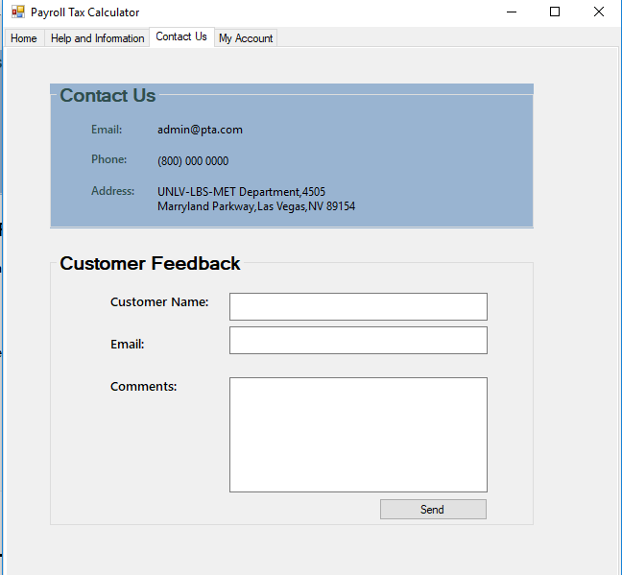
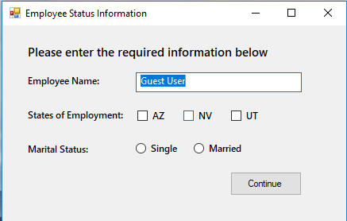
User Interface

Slide 6
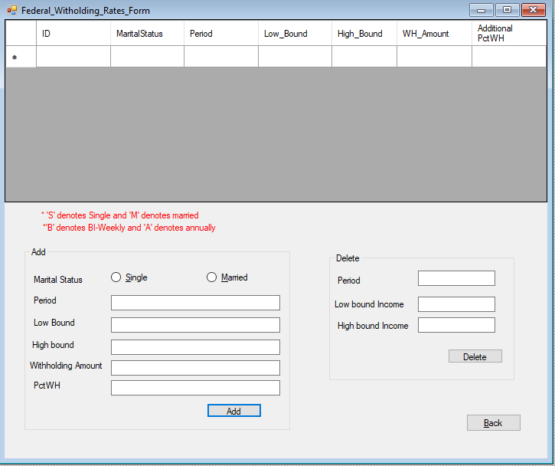
Admin Functions
Includes:
Feedback management
Tax Updates
Home page
Help and Information

Slide 7
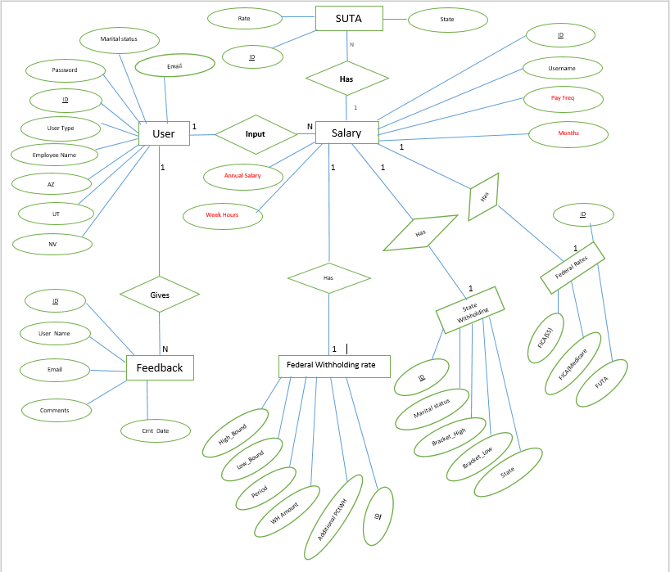
Database Table – Entity Relation
Three main tables for users:
Users – demographic information
Salary – Calculation information
Feedback – User comments

Slide 8
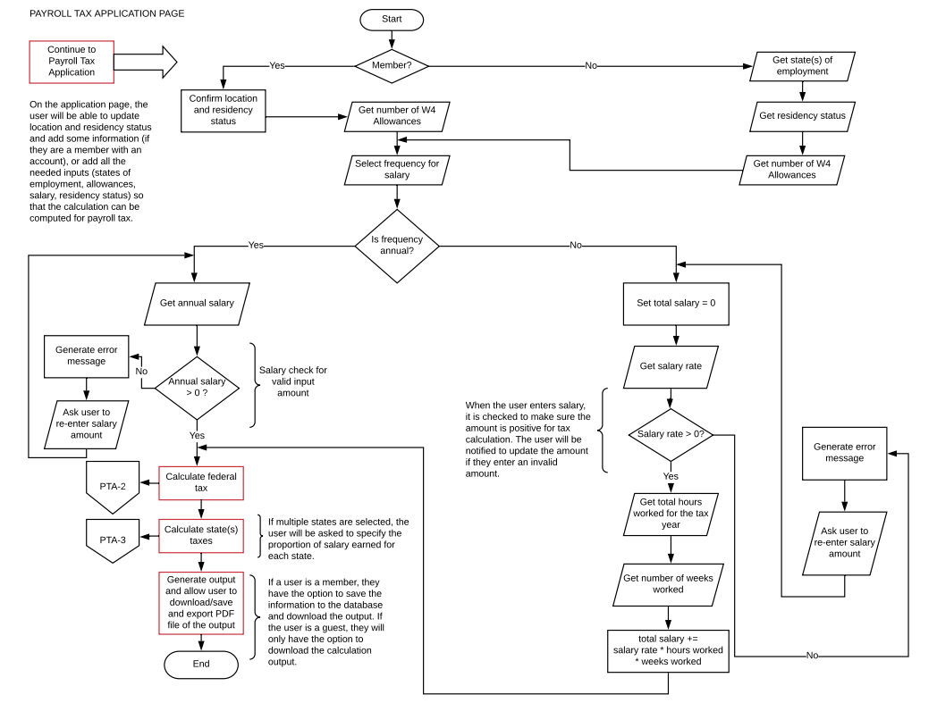
Application Flow
Main application function flow chart

Slide 9
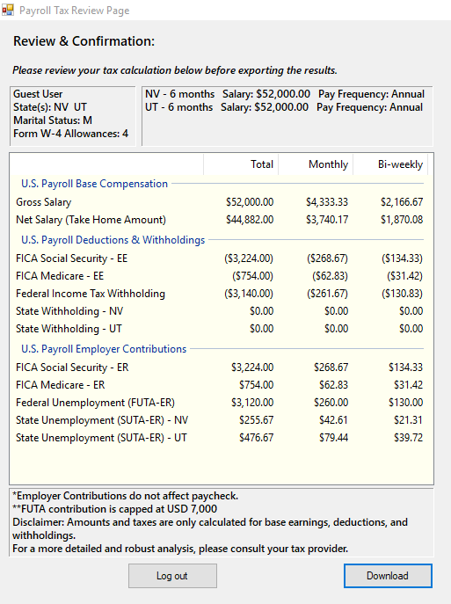
Output
Tax calculation Summary
Includes:
Compensation
Federal Taxes
State Taxes
Federal and state employer contributions

Slide 10
Improvement from Earlier Design
User Interface Design >>> change to more neat and vivid one
Limited scope >>> put a notice on homepage for customer information and will expand scope for future advancement
No social media links needed at this case >>> remove the social links
Multi-Tab appearance was not good >>> split only tab format to multiform display
Output appearance being too busy >>> optimize the elements of export file
Export file type from Excel to PDF >>> provide a PDF for downloading
Market competition of Tax application >>> emphasize our application focusing on Employee side

Slide 11
Application Demo
Run the application now !!

Slide 12

For team work of Group # 2; For contribution from MIS 740 class; For patient help from Instructor Dr. Hu. Wish everyone having a Productive Semester this fall !
We want to say: Thank You !!!

